Slide 1
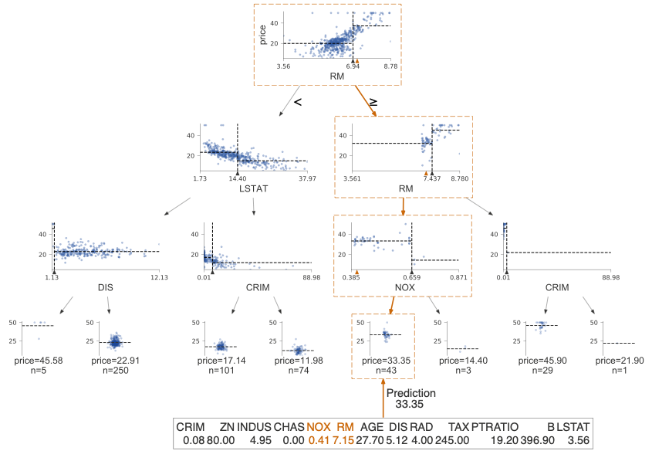
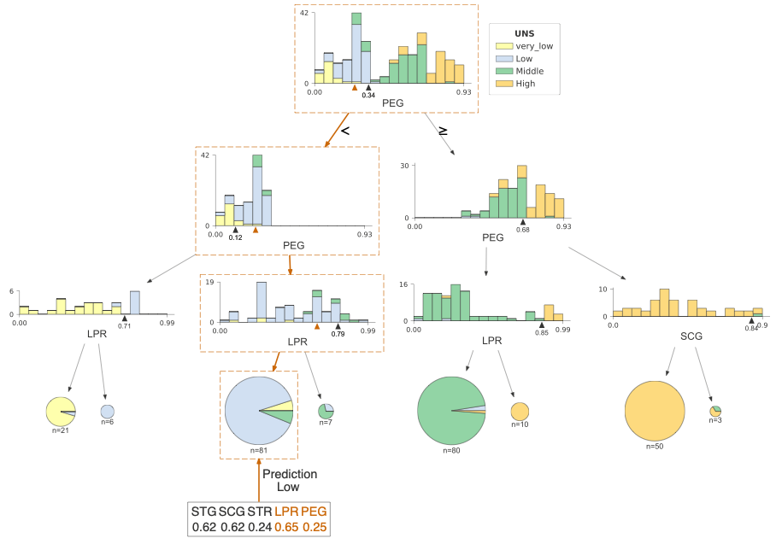
Decision trees
Terence Parr
MSDS program University of San Francisco

Slide 2
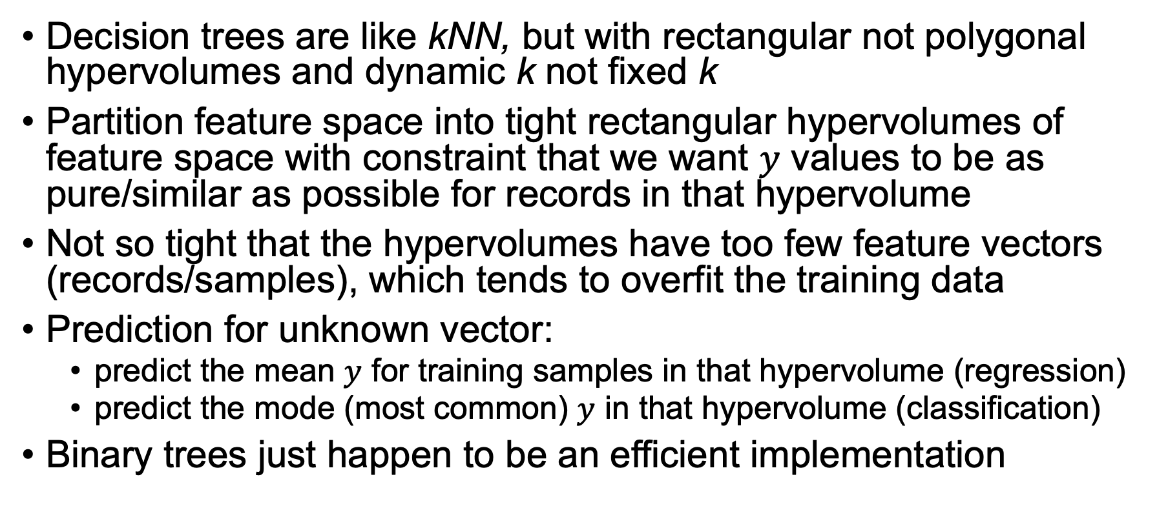
The essence of decision trees
Decision trees are like kNN, but with rectangular not polygonal hypervolumes and dynamic k not fixed k
Partition feature space into tight rectangular hypervolumes of feature space with constraint that we want $y$ values to be as pure/similar as possible for records in that hypervolume
Not so tight that the hypervolumes have too few feature vectors (records/samples), which tends to overfit the training data
Prediction for unknown vector:
predict the mean $y$ for training samples in that hypervolume (regression)
predict the mode (most common) $y$ in that hypervolume (classification)
Binary trees just happen to be an efficient implementation

Slide 3
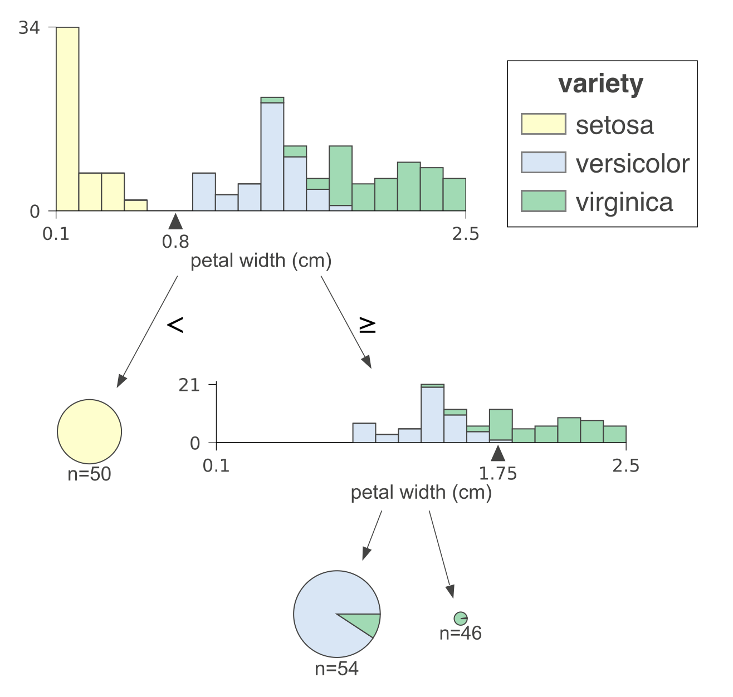
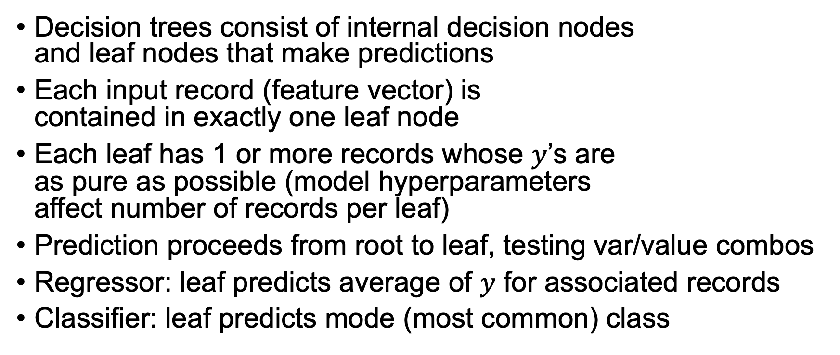
Basic properties of decision tree models
Decision trees consist of internal decision nodes and leaf nodes that make predictions
Each input record (feature vector) is contained in exactly one leaf node
Each leaf has 1 or more records whose $y$’s are as pure as possible (model hyperparameters affect number of records per leaf)
Prediction proceeds from root to leaf, testing var/value combos
Regressor: leaf predicts average of $y$ for associated records
Classifier: leaf predicts mode (most common) class
Most images in these slides from package https://github.com/parrt/dtreeviz

Slide 4
Let’s reinvent decision trees

Slide 5
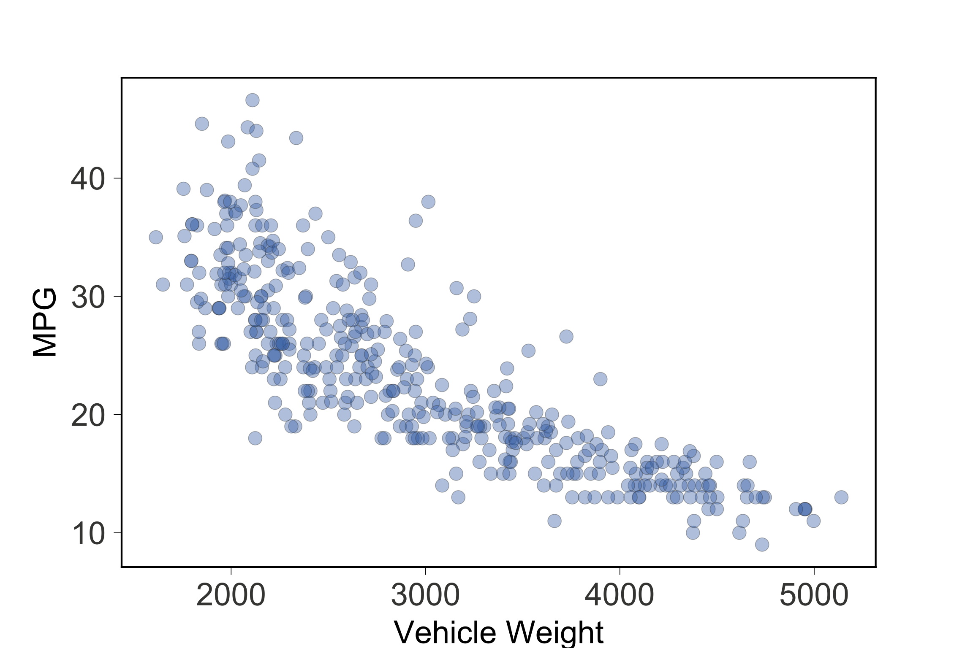
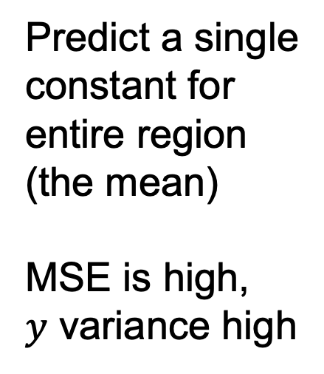
Let’s create a simple regressor in 1D
Predict MPG
from weight
Predict a single
constant for
entire region
(the mean)
MSE is high,
$y$ variance high
Residuals from
point to region
mean

Slide 6
Improve by partitioning, using multiple lines
WHERE DO
WE SPLIT??
Can only use
horizontal lines,
but can use lots
Each region
predicts mean
in piecewise
fashion
Find ranges of WGT with similar MPG values, which
yields a lower
MSE

Slide 7
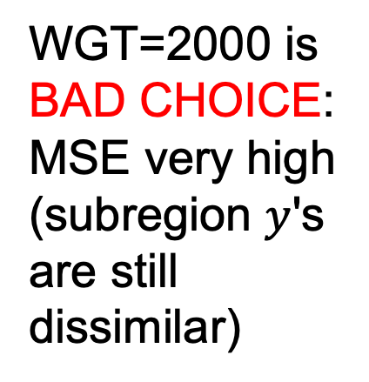
Strategy: find split point giving least MSE
Split WGT
into two
subregions,
each
predicting
mean
WGT=2000 is
BAD CHOICE:
MSE very high (subregion $y$'s are still dissimilar)
BOO!

Slide 8
Strategy: find split point giving least MSE
Split WGT
into two
subregions,
each
predicting
mean
WGT=3500 is
ANOTHER
BAD CHOICE:
MSE very high (still dissimilar)
BOO!
Note: MSE for mean model is same as variance
(average squared difference from mean)

Slide 9
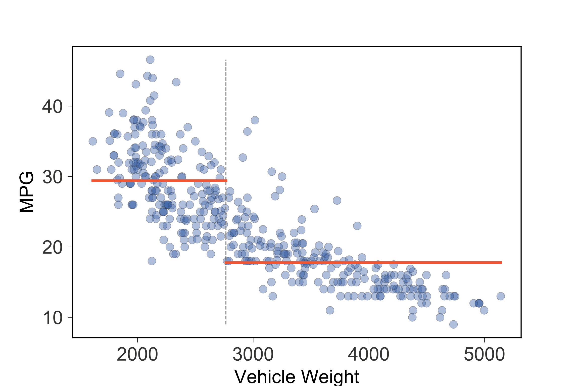
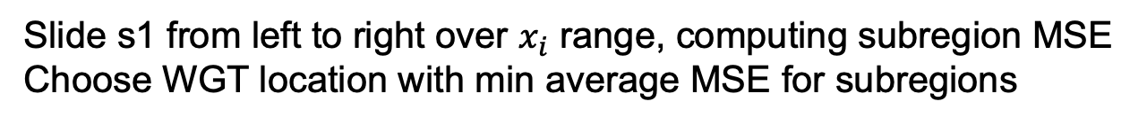
A split exists that gives min MSE for regions
Technique: Exhaustively
check all feature
values, computing MSE or variance of subregions for each split
Choose split point
giving min MSE
Not bad!
s1
Slide s1 from left to right over $x_{i}$ range, computing subregion MSE
Choose WGT location with min average MSE for subregions

Slide 10
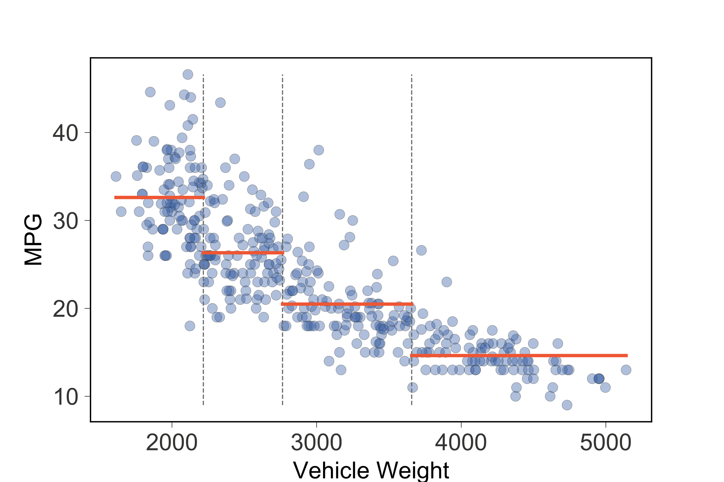
Now split those 2 regions to get 4 regions
Split s1 stays,
recursively split
left/right regions to
get splits s2, s3
Kinda like binary
search or other
divide-and-conquer
strategy
s2
s1
s3
Slide s2 from left to s1, computing MSEs; choose $x$ location with min avg MSE
Slide s3 from s1 to right, computing MSEs; choose $x$ location with min avg MSE

Slide 11
Recursive call-tree from model training gives regions defined by splits s1,s2,s3
s1=split(1000,5000)
s2=split(1000,s1)
s3=split(s1,5000)
s2
s1
s3
[1000,s2)
[s2,s1)
[s1,s3)
[s3,5000)
Split (recurse) until one of:
All potential splits do not reduce MSE
All nodes have min num samples
Max number of splits reached
Etc…
Predictions are avg of MPG
(target) values in subregions

Slide 12
Hardcoded non-tree model implementation
To partition space, test in recursion/split order
if x<s1 and x<s2: predict 32.6
if x<s1 and x>=s2: predict 26.3
if x>=s1 and x<s3: predict 20.5
if x>=s1 and x>=s3: predict 14.6
s2
s1
s3
Note repeated comparisons!

Slide 13
Factor the split comparisons for efficiency
if x<s1:
if x<s2: predict 32.6
else: predict 26.3
else:
if x<s3: predict 20.5
else: predict 14.6
s2
s1
s3
But, don’t want to hardcode model!

Slide 14
Represent nested conditionals as tree
if x<s1:
if x<s2: predict 32.6
else: predict 26.3
else:
if x<s3: predict 20.5
else: predict 14.6
rotate 90°
s2
s1
s3
s1
<
>=
Internal nodes test features
Leaves predict region mean
s2
s3
<
>=
<
>=
32.6
26.3
20.5
14.6
We morph tree of recursion from training into decision tree!

Slide 15
1D feature space vs dtreeviz decision tree
s1
s2
s3
s2
s1
s3
https://github.com/parrt/msds621/blob/master/notebooks/trees/partitioning.ipynb

Slide 16
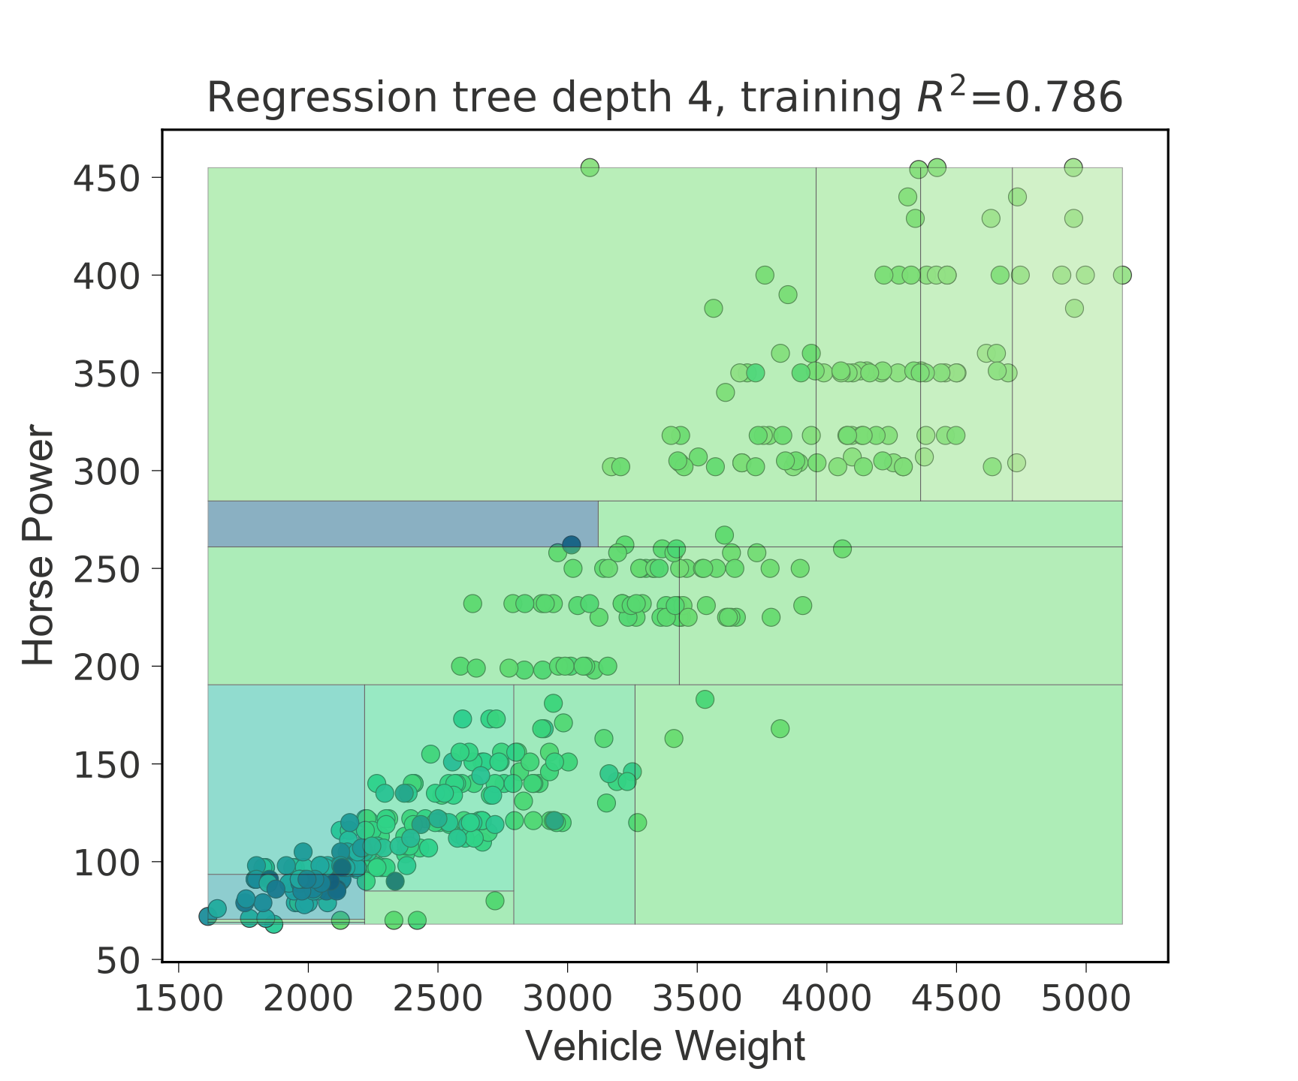
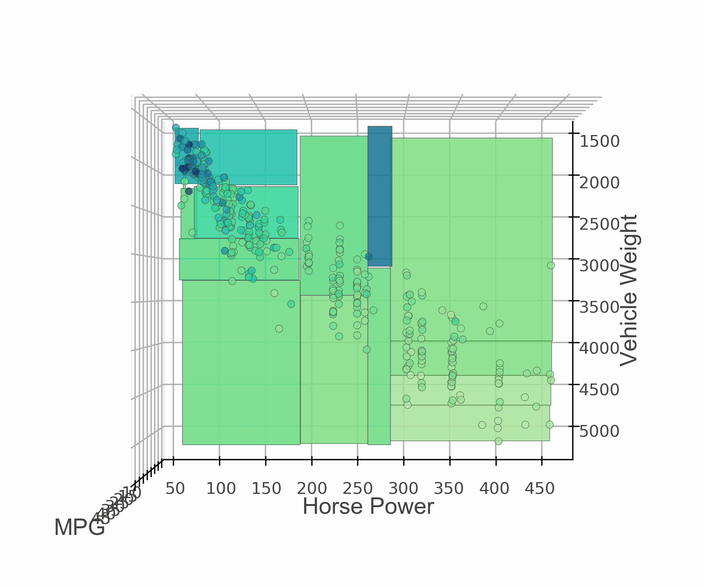
2D regressor feature space (heatmap, 3D)

Slide 17
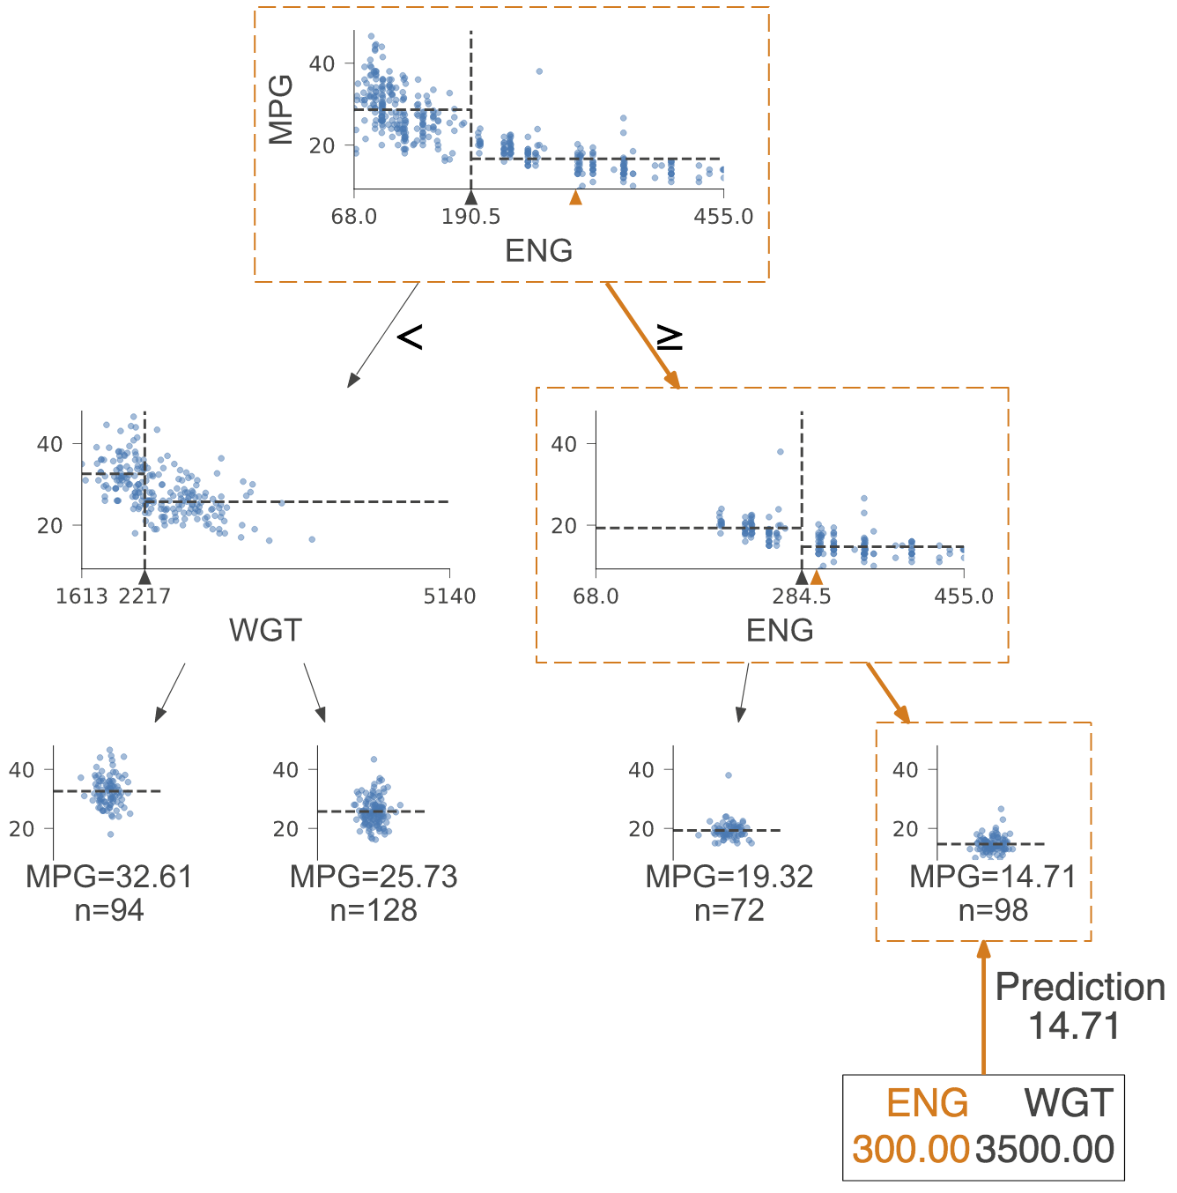
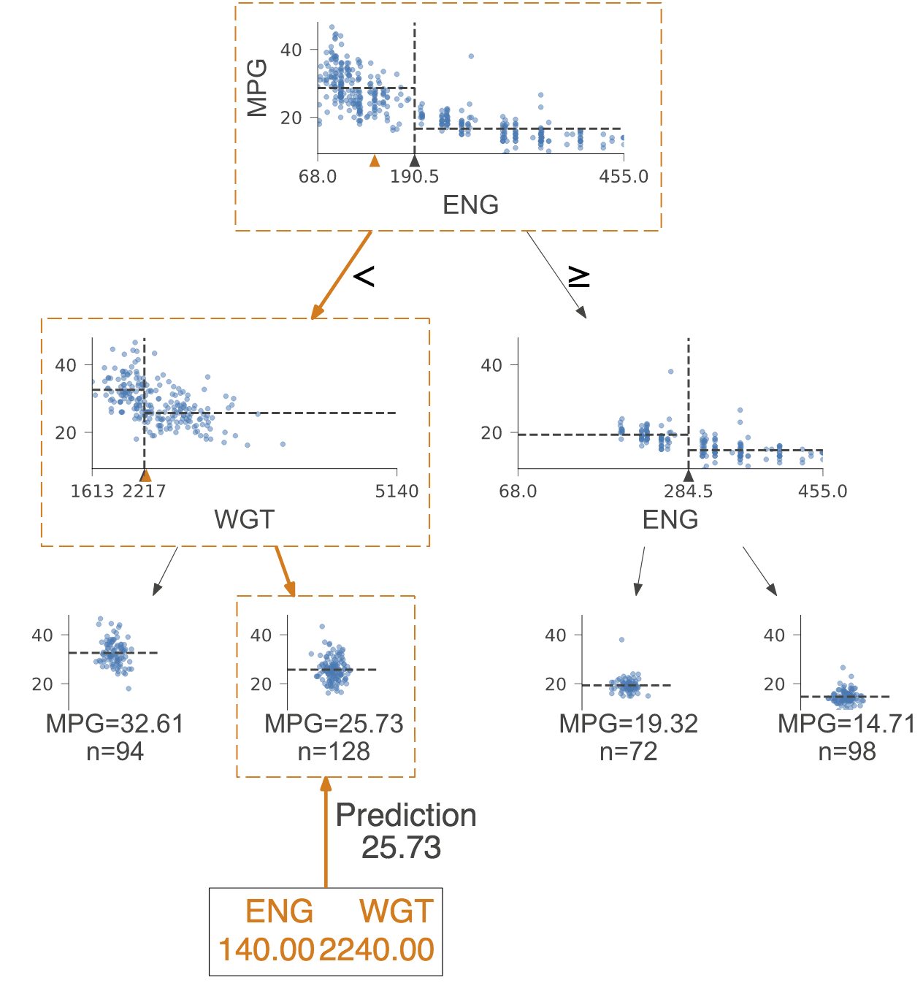
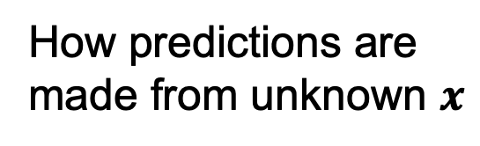
How predictions are
made from unknown $x$

Slide 18
An aside: partitioning, tree viz done with custom library
Do “pip install dtreeviz”
Partially built with Prince Grover, previous MSDS student
See https://github.com/parrt/dtreeviz and the article for more detail: https://explained.ai/decision-tree-viz/index.html
Advice: never accept status quo; always strive for more / better
See “How to lead a fulfilling life by being dissatisfied” buried in my talk on decision tree viz https://twitter.com/the_antlr_guy/status/1120359898062000128

Slide 19
Classifiers

Slide 20
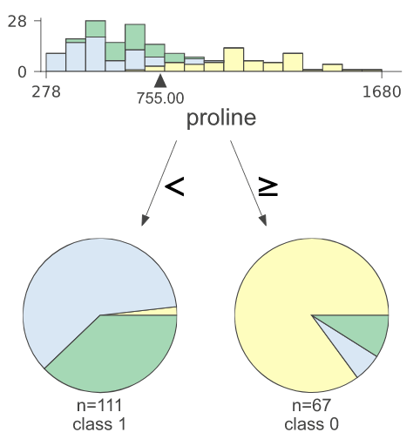
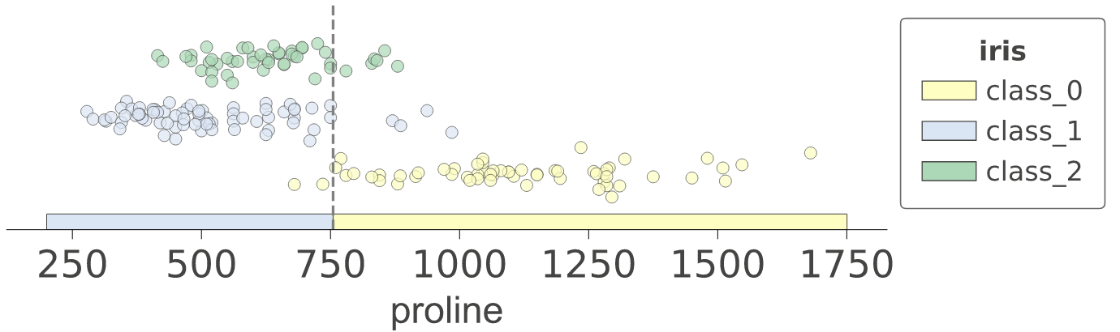
Classifiers split feature space too
Predict wine
from proline
Internal decision nodes test features just like regressor trees
Leaves predict most common target category (mode) not mean
Find split that decreases average impurity of left/right subregions (we'll need a definition of impurity for categories)
s1
https://github.com/parrt/msds621/blob/master/notebooks/trees/partitioning.ipynb

Slide 21
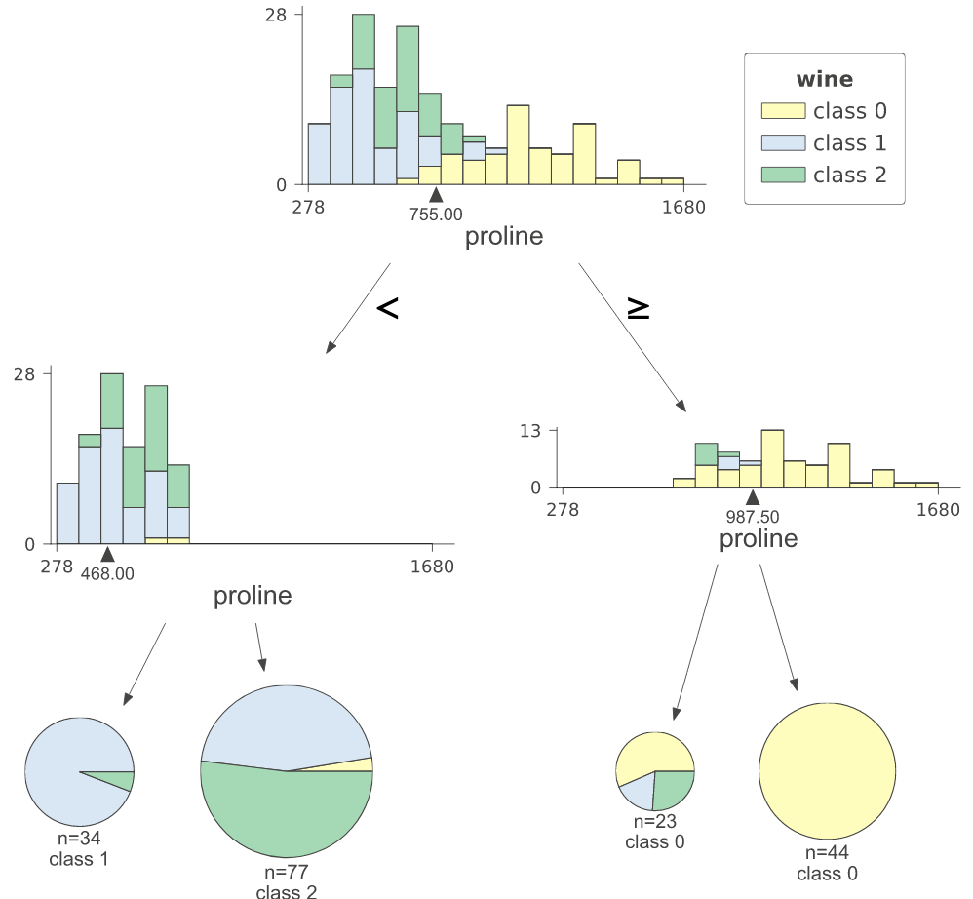
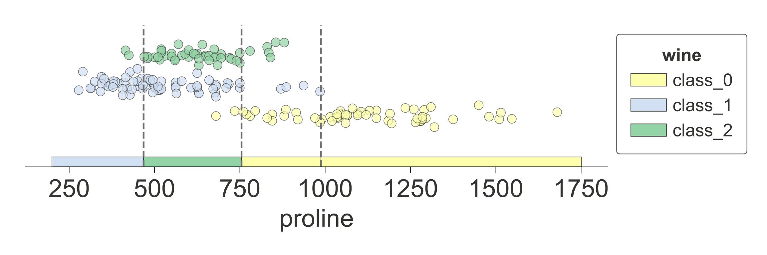
Split s1 subregions into more subregions
All splits use same proline variable
s2
s1
s3
Still not very pure though

Slide 22
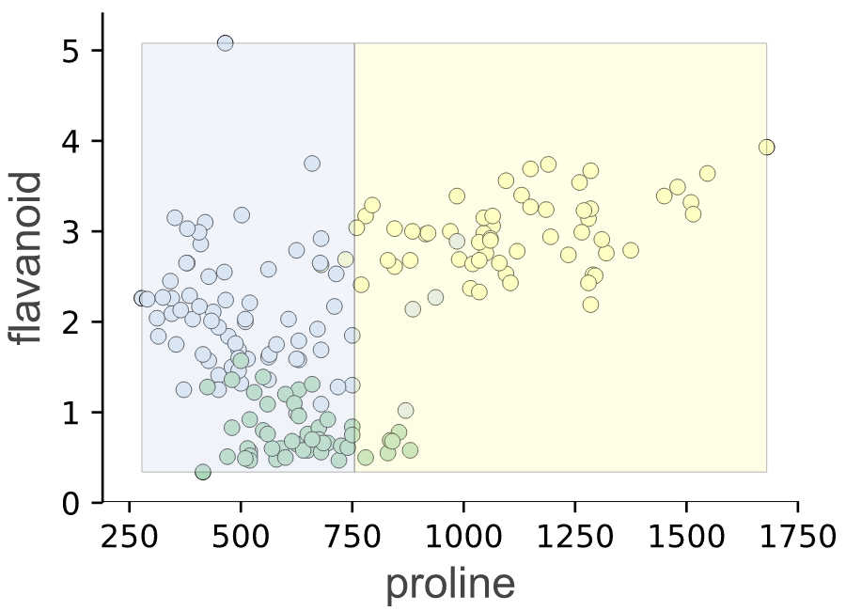
To improve predictions: Use 2 features and split 2D feature space into regions
s1
Training looks for (feature, split point)
combos giving more pure subregions.
To test: decision nodes compare single feature value in subset of records to split point

Slide 23
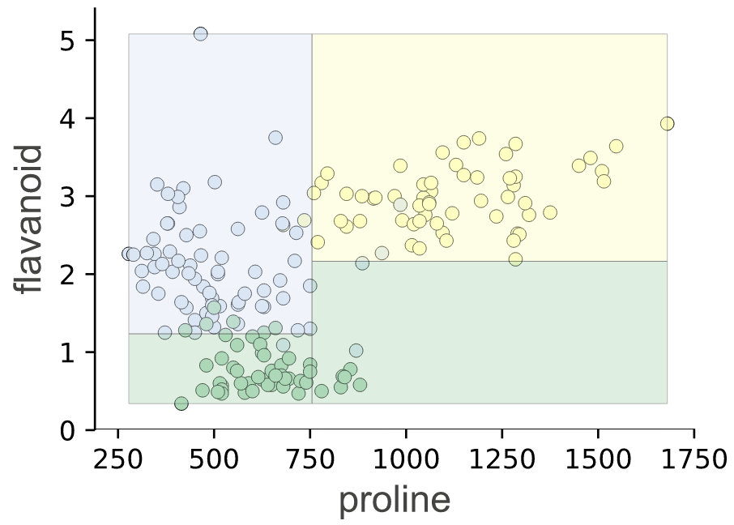
To improve predictions: Use 2 features and split 2D feature space into regions
s3
s2
s1
Training looks for (feature, split point)
combos giving more pure subregions.
To test: decision nodes compare single feature value in subset of records to split point

Slide 24
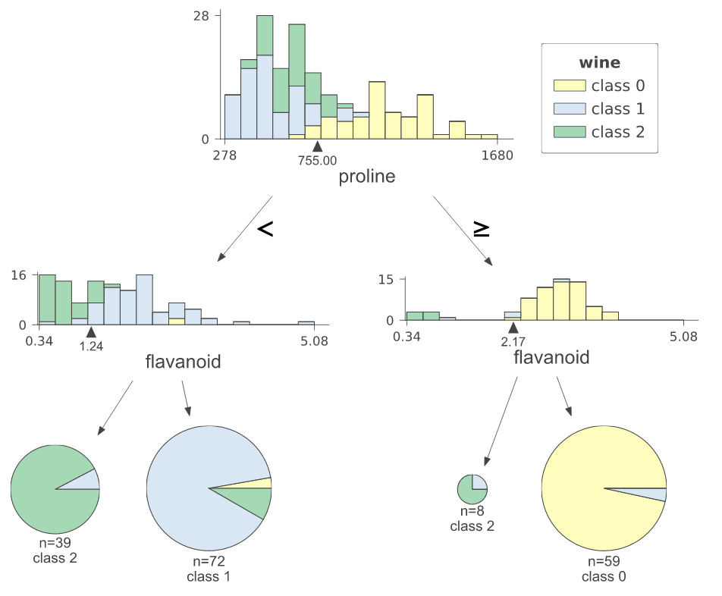
Compare depth=2 trees for 1D, 2D vars
All splits use same proline variable
Splits use proline and flavanoid

Slide 25
For bigger trees, can do nonfancy plot, leaf plots
Leaf stacked barcharts showing samples per class

Slide 26
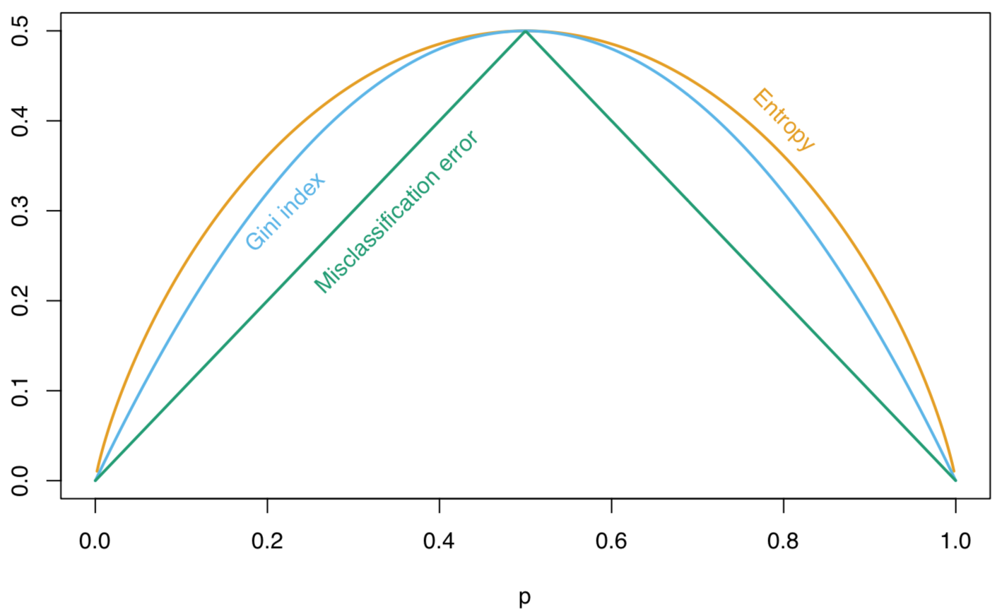
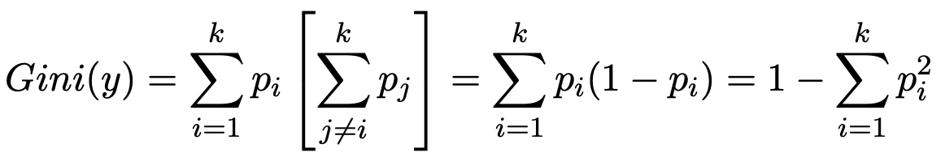
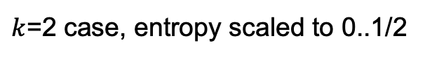
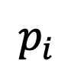
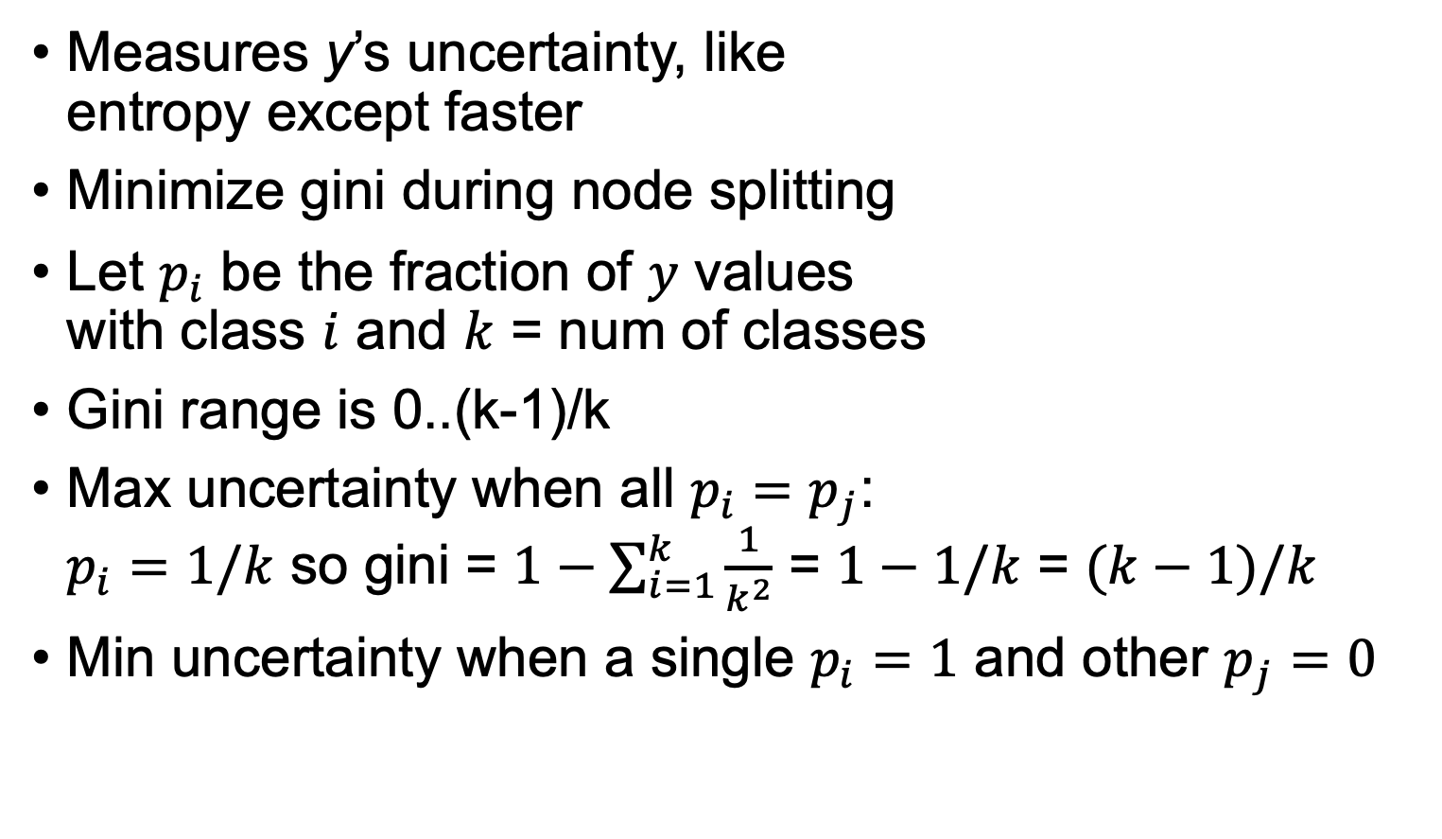
Node impurity: Gini impurity
Measures y’s uncertainty, like entropy except faster
Minimize gini during node splitting
Let $p_{i}$ be the fraction of $y$ values with class $i$ and $k$ = num of classes
Gini range is 0..(k-1)/k
Max uncertainty when all $p_{i}=p_{j}$: $p_{i}=1/k$ so gini = $1−\sum_{i=1}^{k}{\frac{1}{k^{2}}}$ = $1−1/k$ = $(k−1)/k$
Min uncertainty when a single $p_{i}=1$ and other $p_{j}=0$
$k$=2 case, entropy scaled to 0..1/2
$$p_{i}$$
See https://github.com/parrt/msds621/blob/master/notebooks/trees/gini-impurity.ipynb

Slide 27
Tree structure’s effect on prediction error

Slide 28
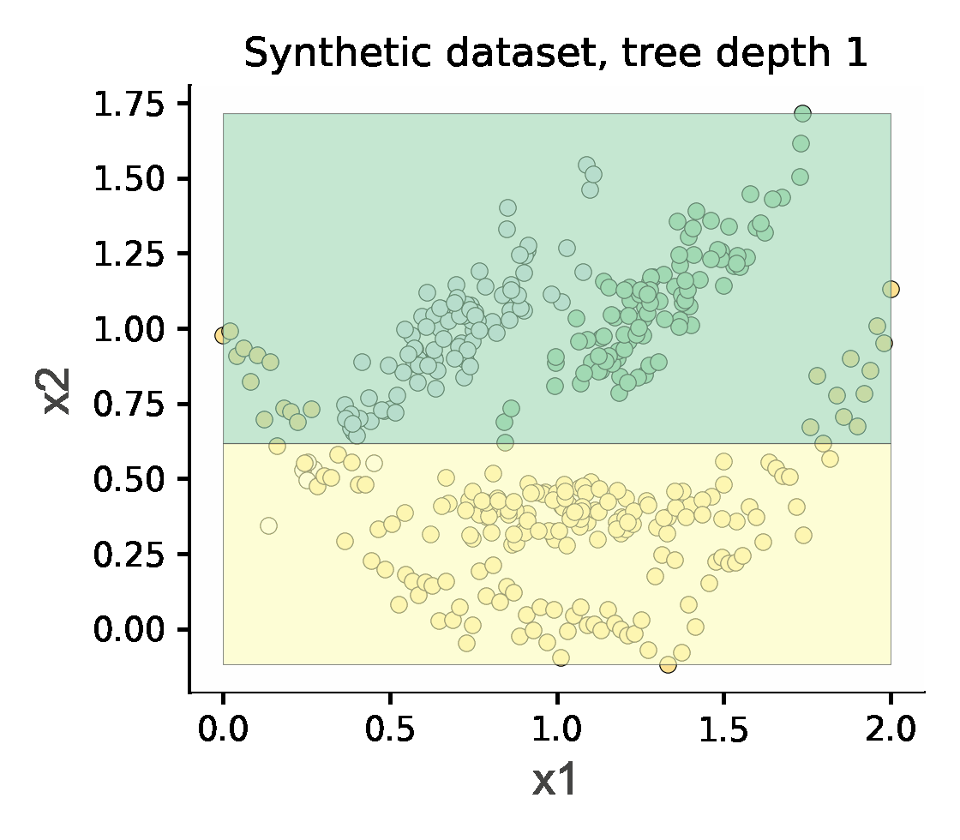
Hyperparameter max_depth
Restricts how many splits tree can make, preventing tree from getting too specific to training set (zeroing in on outliers)

Slide 29
Hyperparameter min_samples_leaf
Idea: don’t split regions w/less than min_samples_leaf records
Similar to limiting height of tree but finer granularity of control
More direct control of generality than tree height
Degenerate case where min_samples_leaf=n (sample size)
What does such a regressor predict?
What does such a classifier predict?
Describe accuracy of this extreme model
If we trained on many different training sets pulled from same data distribution, how stable would the test set prediction error be? (What does that say about variance/generality?)
https://github.com/parrt/msds621/blob/master/notebooks/trees/decision-trees.ipynb

Slide 30
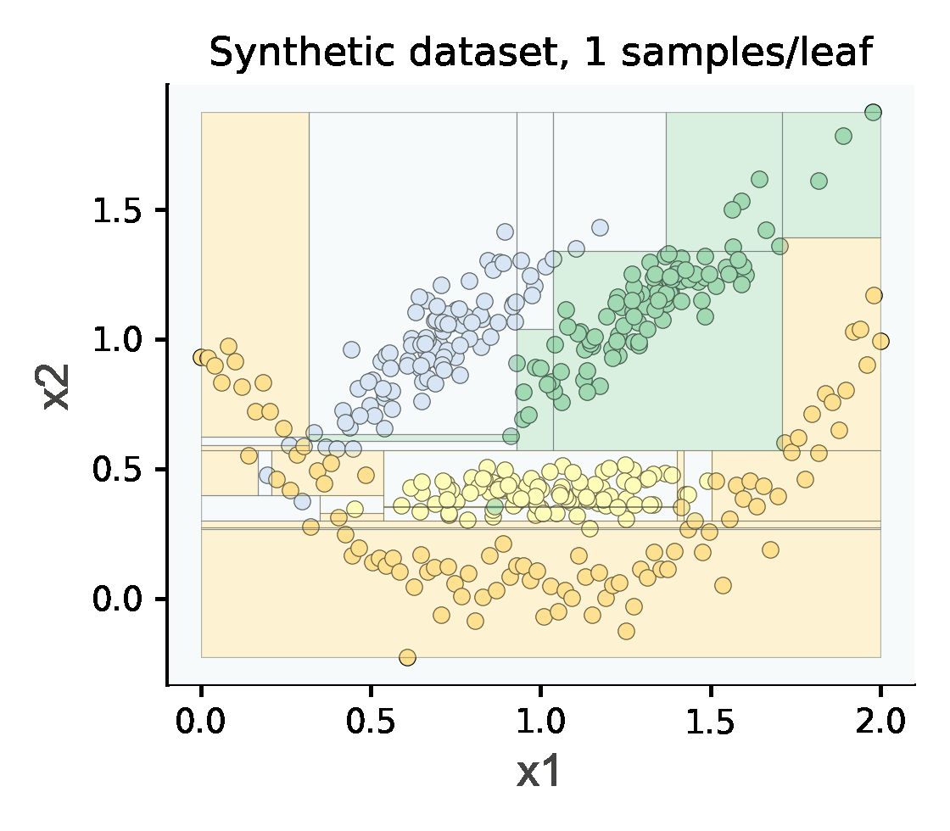
2D tesselation varying min samples/leaf in action
As min leaf size gets bigger, more general but less accurate

Slide 31
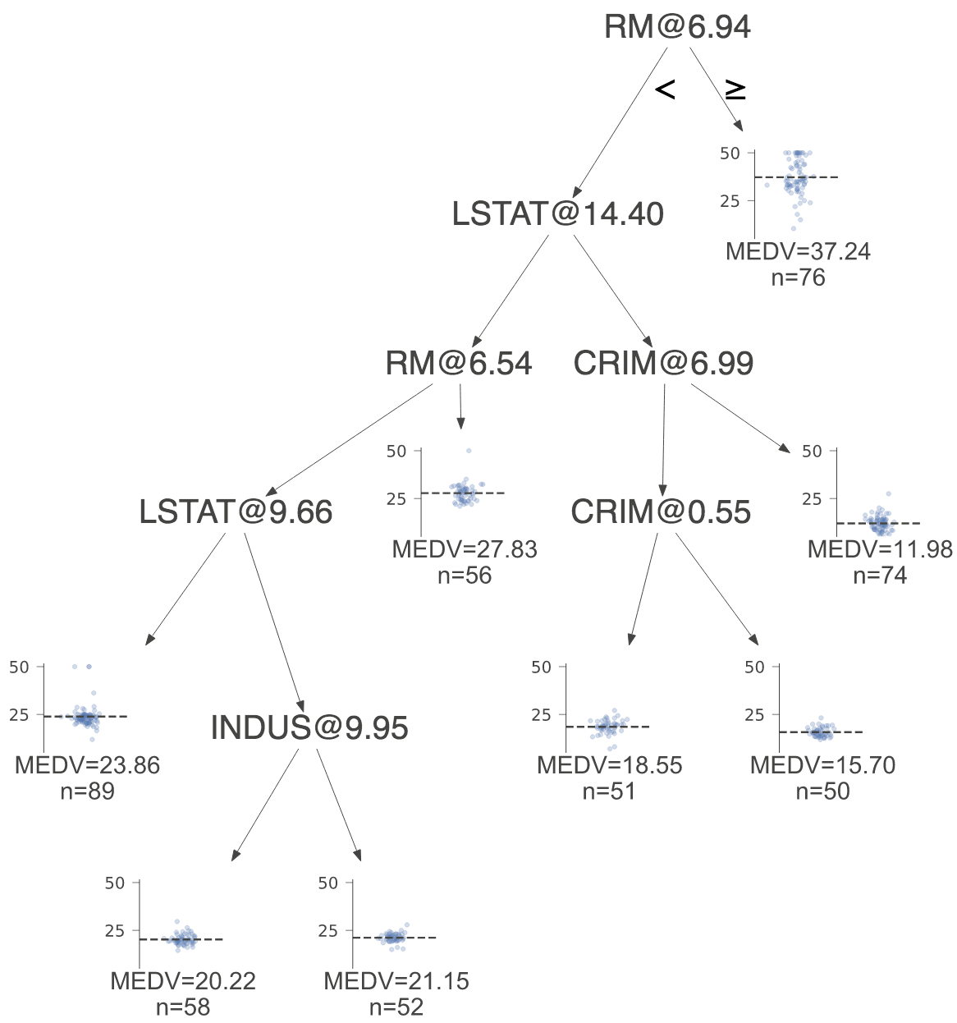
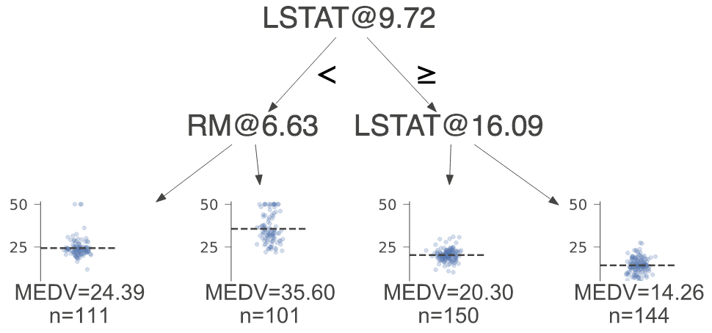
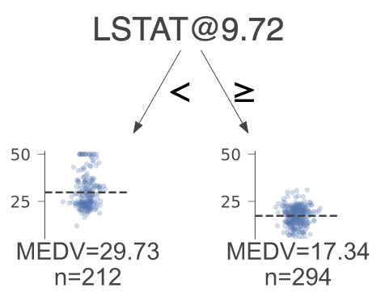
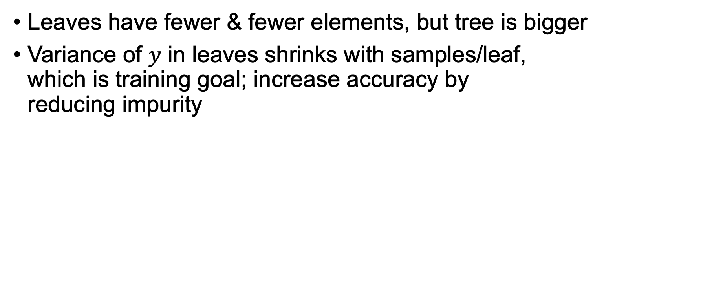
Trees for 200,100,50 samples per leaf (Boston housing data, n=506 records)
Leaves have fewer & fewer elements, but tree is bigger
Variance of $y$ in leaves shrinks with samples/leaf, which is training goal; increase accuracy by reducing impurity

Slide 32
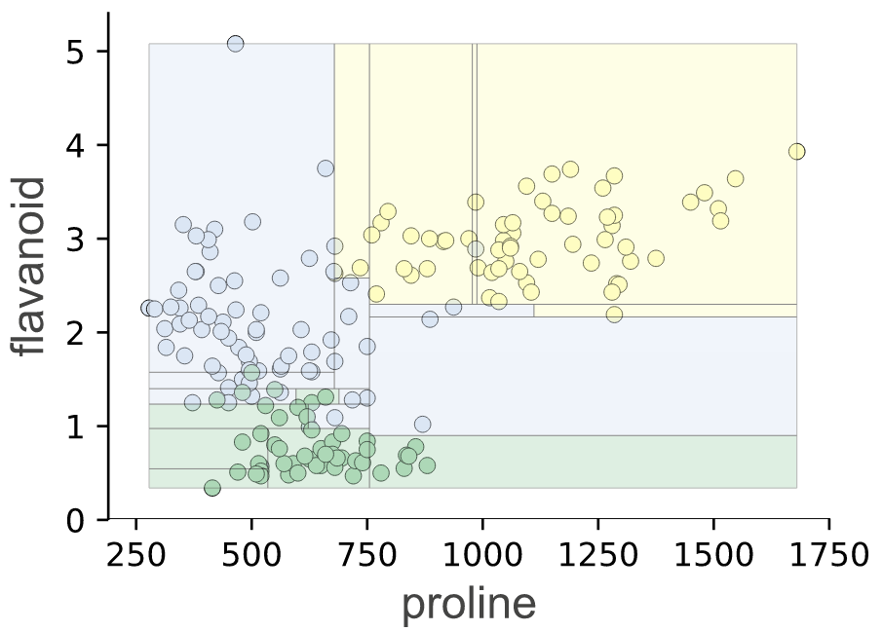
What happens with very small leaves?
Max depth 5
Check out that lonely blue dot in sea of yellow! (let’s assume tiny region is blue)
We let model get overly specific; it’s overfit
Accuracy on training set is very high, but at
the cost of generality; test set error is higher
than necessary
(Wine data set)

Slide 33
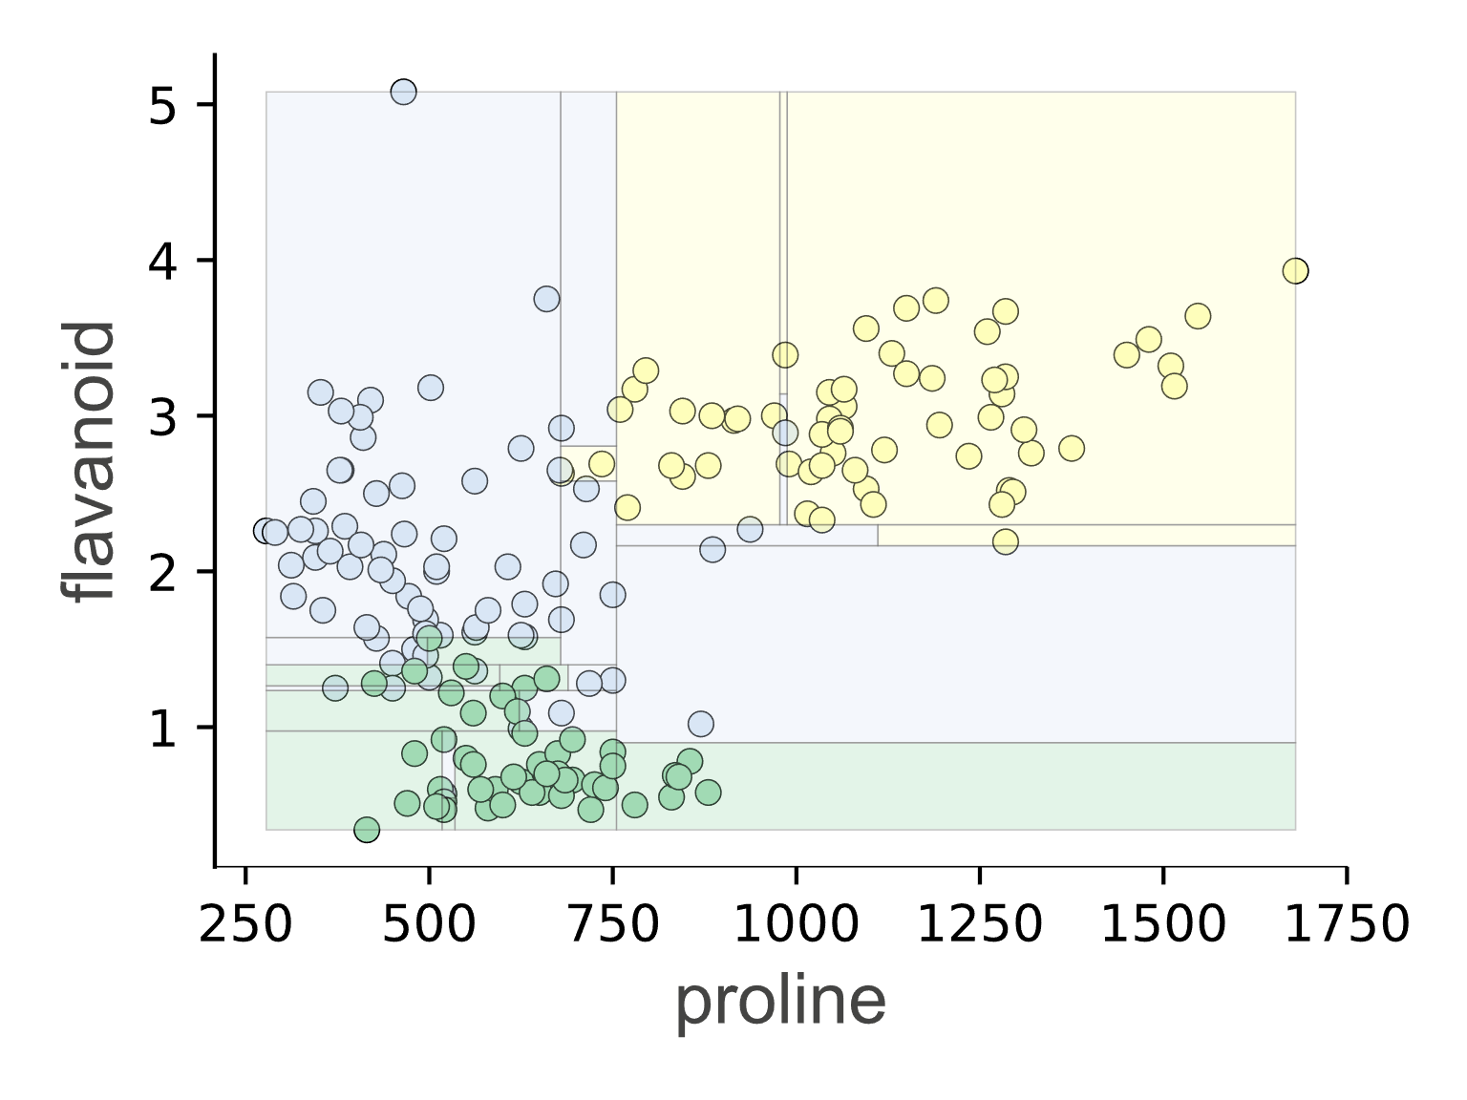
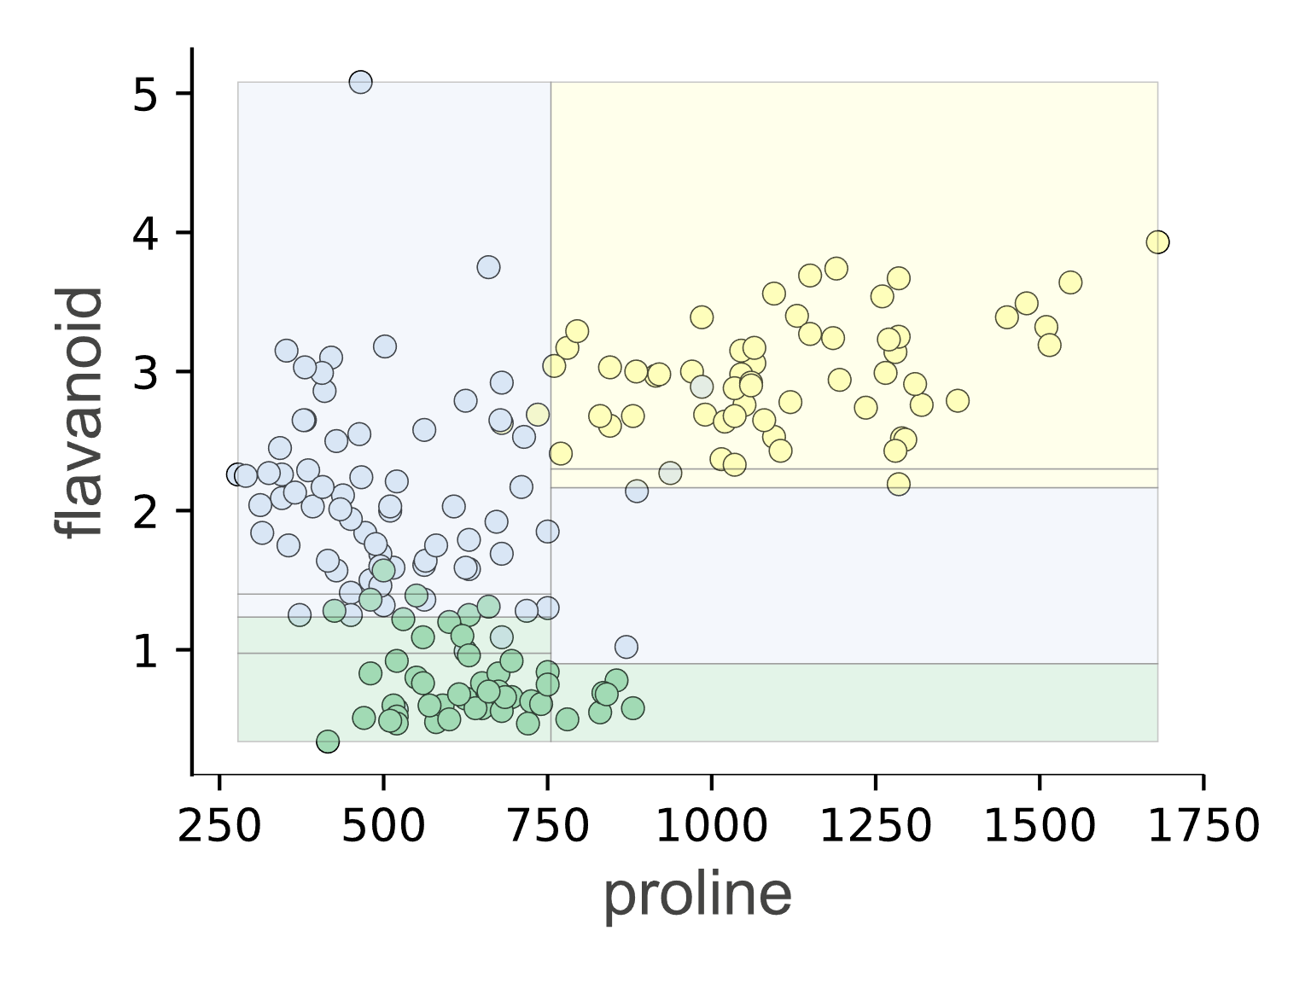
How could we (likely) improve generality?
Max depth 3 or
min samples / leaf 10
Max depth 5
Blue dot now gets classified as yellow
(Wine data set)

Slide 34
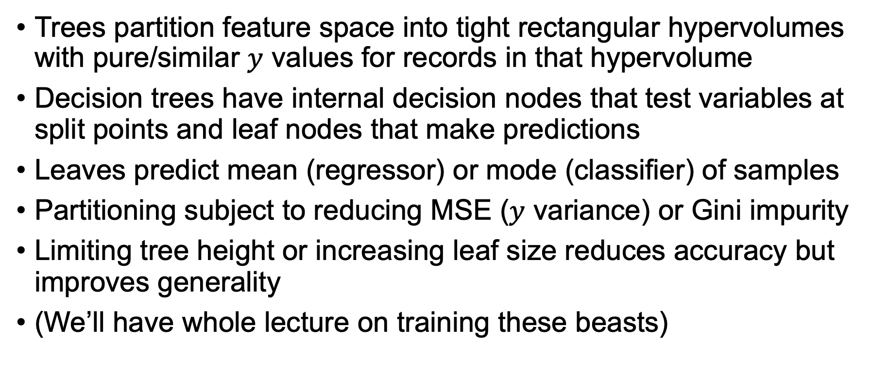
Key takeaways
Trees partition feature space into tight rectangular hypervolumes with pure/similar $y$ values for records in that hypervolume
Decision trees have internal decision nodes that test variables at split points and leaf nodes that make predictions
Leaves predict mean (regressor) or mode (classifier) of samples
Partitioning subject to reducing MSE ($y$ variance) or Gini impurity
Limiting tree height or increasing leaf size reduces accuracy but improves generality
(We’ll have whole lecture on training these beasts)

Slide 35
Lab time
Partitioning feature space https://github.com/parrt/msds621/blob/master/labs/trees/partitioning-feature-space.ipynb

